Slide 1
Connected Devices Raspberry Pi – Rotation 1
David Crook
@Data4Bots
Questions: dacrook@Microsoft.com

Slide 2
Agenda
The ‘me’ slide
Things to know
Goals
Content
Summary
Continuous Q&A

Slide 3
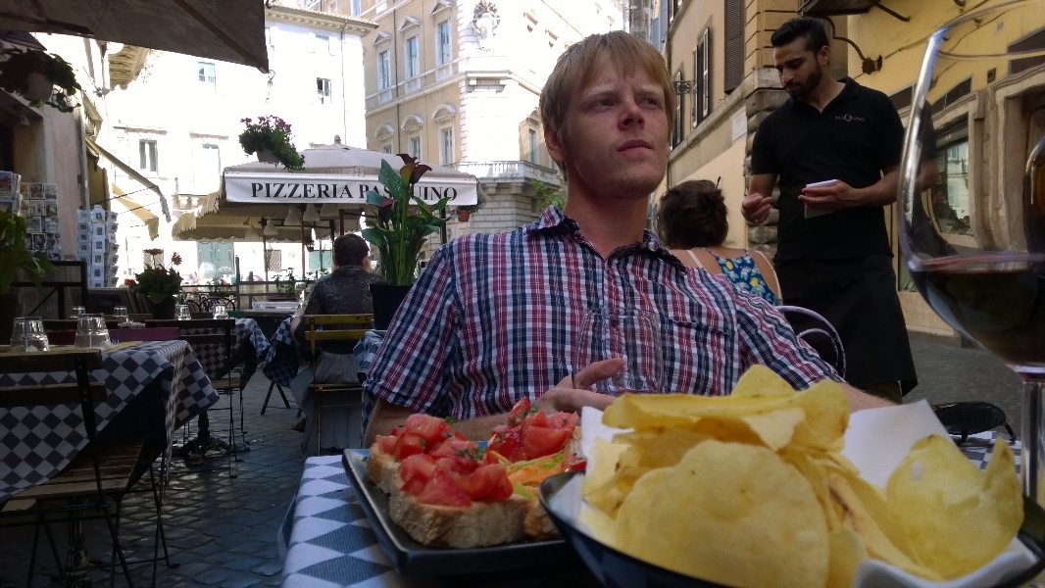
David Crook
Microsoft Developer Evangelist
Focused on Machine Learning and Embedded Systems
Enjoys challenges
Likes Fishing + Brazilian Jiu Jitsu
Typically not together
dacrook@Microsoft.com
(980)228-6278
@Data4Bots
www.indiedevspot.com

Slide 4
Stuff you should Know About
Additional Resources
Channel9: http://channel9.msdn.com
Hackster: https://www.hackster.io
Stack Overflow: http://electronics.stackexchange.com/
BizSpark
Free Azure
Free Tools Network Partner Give to your startups for free
Microsoft Innovation Center
Hack Tuesdays: Mentoring every Tuesday 11am – 2pm
Free Co-Working for Startups: dacrook@Microsoft.com to apply
Free Training: See schedule here: http://indiedevspot.com/events/

Slide 5
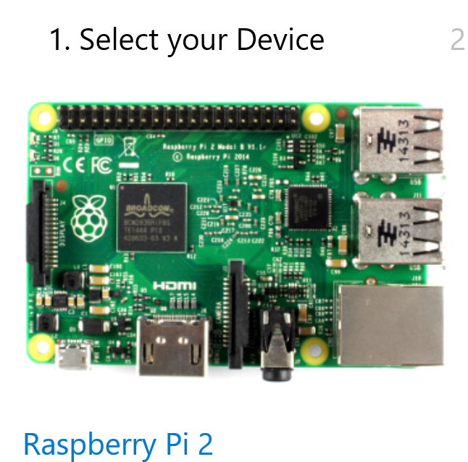
Future Reference Getting Started
http://ms-iot.github.io/content/en-US/GetStarted.htm

Slide 6
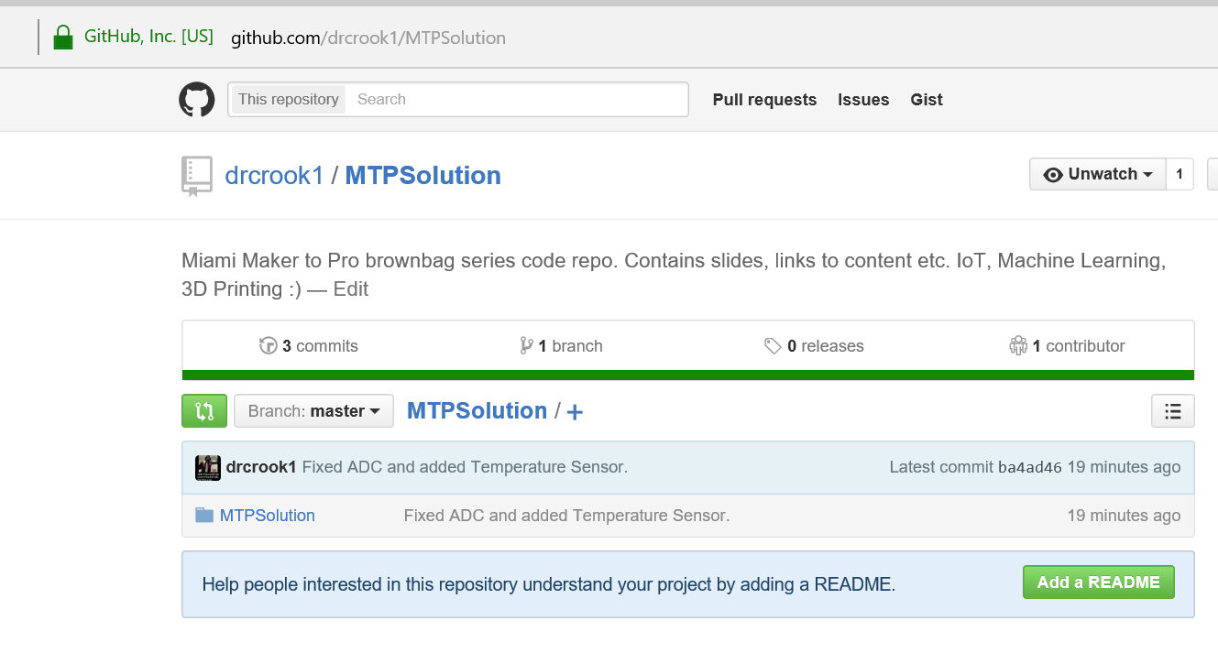
Get the Codes
https://github.com/drcrook1/MTPSolution

Slide 7
Goals of Presentation
Define IoT
Define how Azure facilitates IoT
SQL Azure
IoT Hub and Stream Analytics
Visualizing Data in a Website

Slide 8
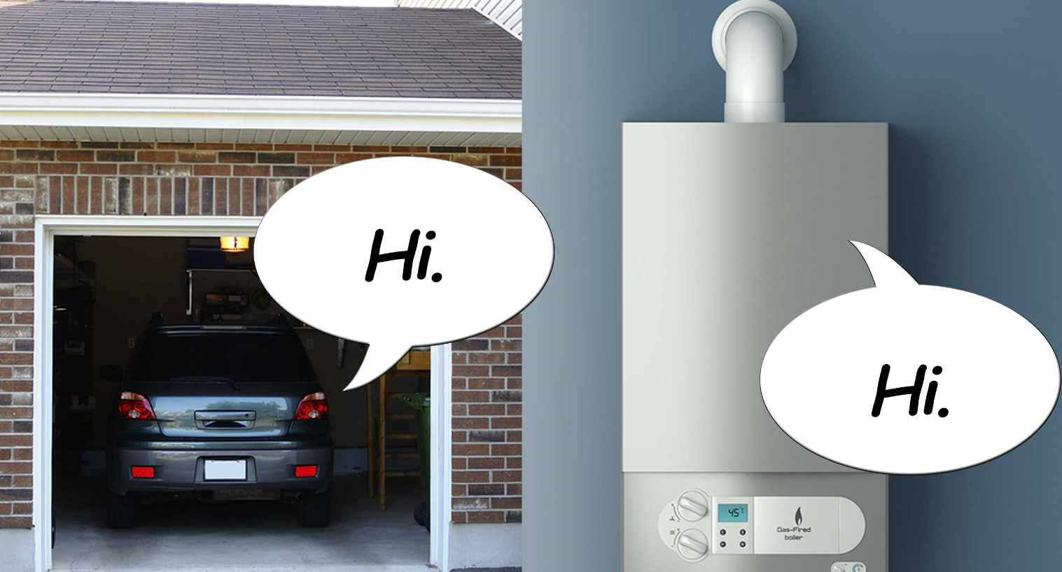
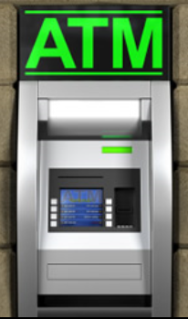
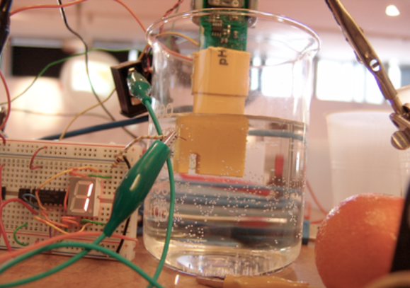
What is IoT?
Internet of Things
Connected Devices
Aggregation of Data
Similar to old concepts
Notes:
Differentiating factor from just internet connected devices is the paradigm that you collect data and push intelligence to IoT devices.

Slide 9

Azure + IoT
Azure = Microsoft Cloud Platform
Message Passing
Databases
Analytics Clusters
Servers
Machine Learning
Load Balancing
Websites
Notes:
PaaS vs IaaS vs SaaS
-> Focus on PaaS

Slide 10
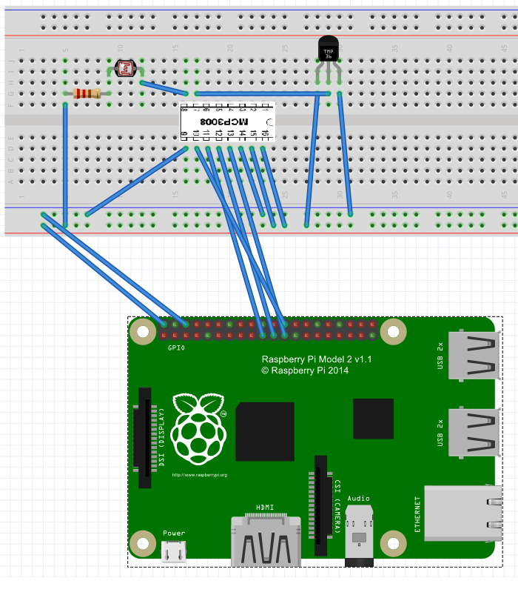
Initial Wiring
Analog Digital Converter
Photo Resistor
Temperature Sensor
Ensure you double check
It can be hazardous if wrong.

Slide 11
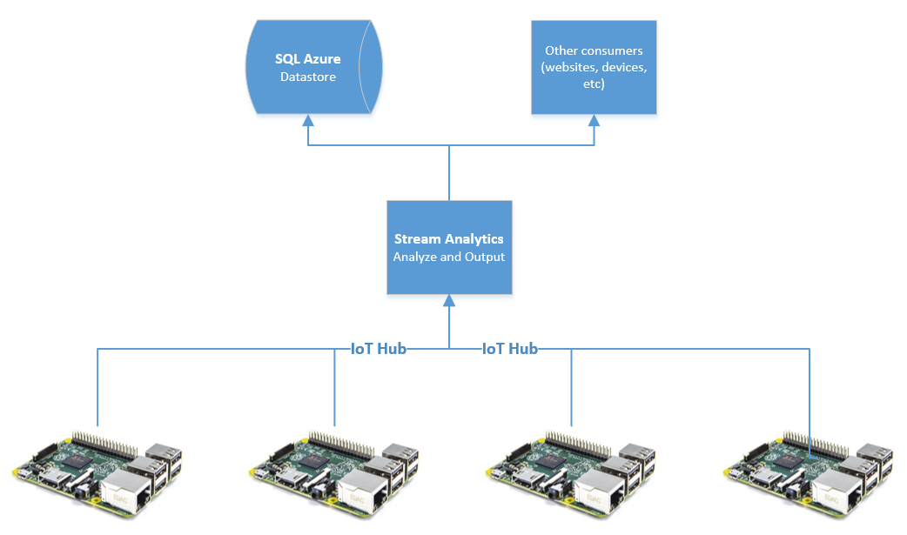
SQL Azure, Stream Analytics and IoT Hub
Place to store data
Analyze live data
Way to ingest data
Notes:
During this time ensure everybody logs into Azure

Slide 12
Walk through – Azure Portal
Basic Walk around
Old portal
New portal
Provision SQL Server
Provision IoT Hub
Provision Stream Analytics

Slide 13
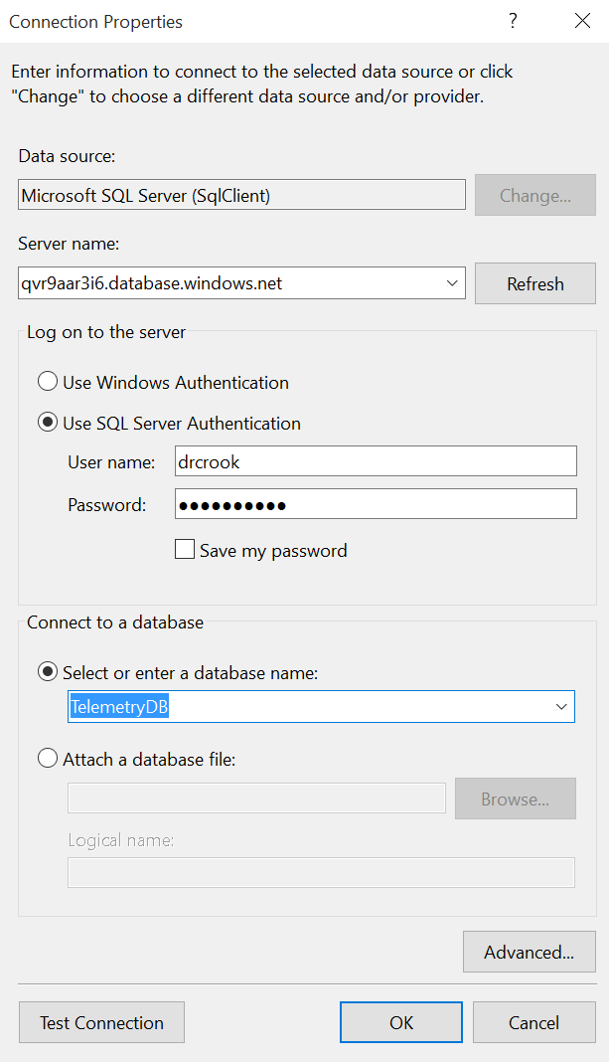
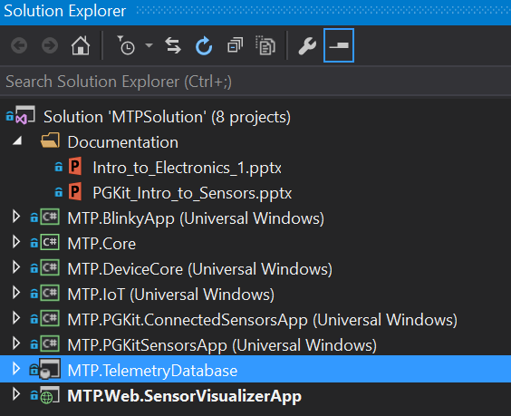
Deploy SQL Server Schema
https://channel9.msdn.com/Blogs/Have-you-tried-turning-it-off-and-on-again/Deploying-Database-Projects-to-SQL-Azure
Right Click DB Project - Publish
Notes:
Make sure to show where to get these settings from in the Azure portal.
Use the channel9 video for reference if needed.
https://channel9.msdn.com/Blogs/Have-you-tried-turning-it-off-and-on-again/Deploying-Database-Projects-to-SQL-Azure

Slide 14
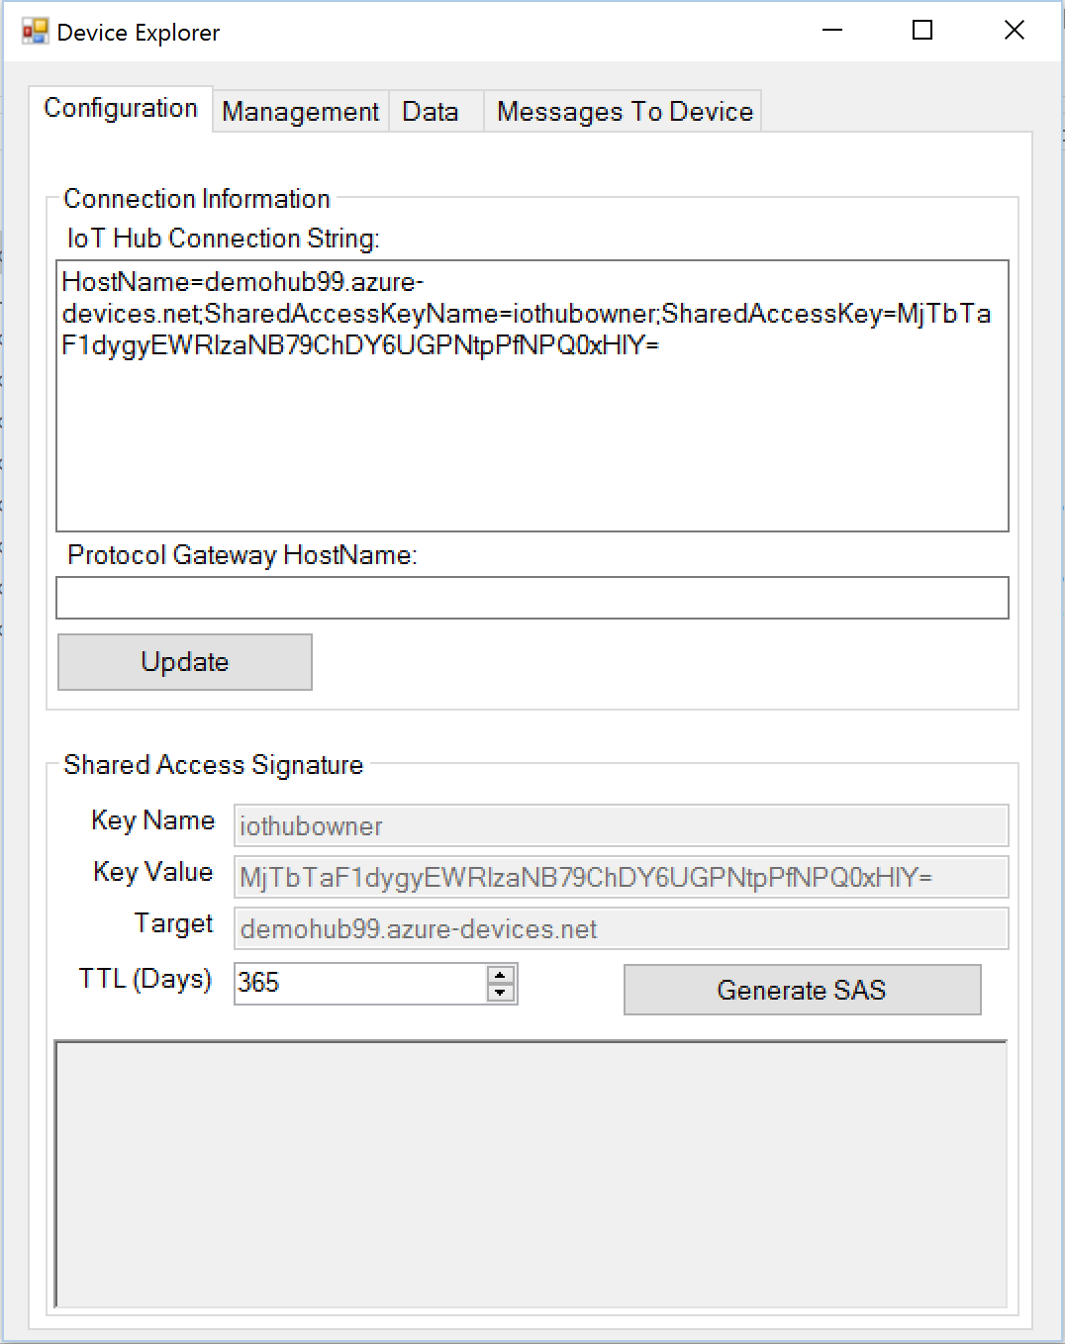
Install Device Monitor
https://github.com/Azure/azure-iot-sdks/releases/download/v1.0.0-preview.4/SetupDeviceExplorer.msi
C:\Program Files (x86)\Microsoft\DeviceExplorer
Notes:
To get IoT Hub connection string, you must be on the new portal

Slide 15
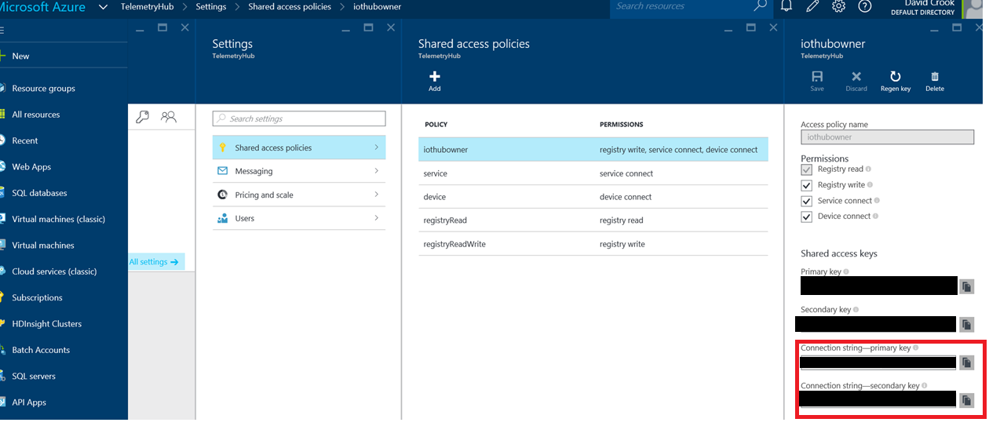
Get IoT Hub Connection String

Slide 16
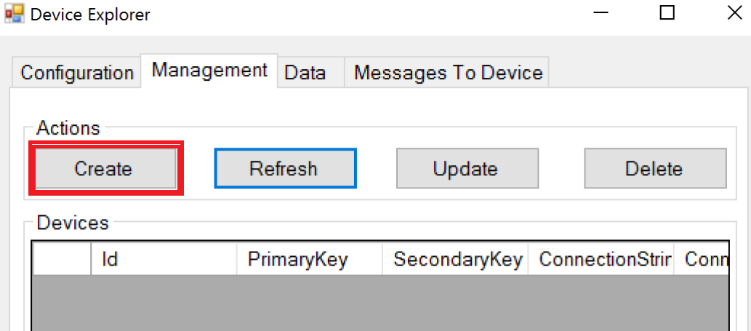
Manage Devices – Create New Device

Slide 17
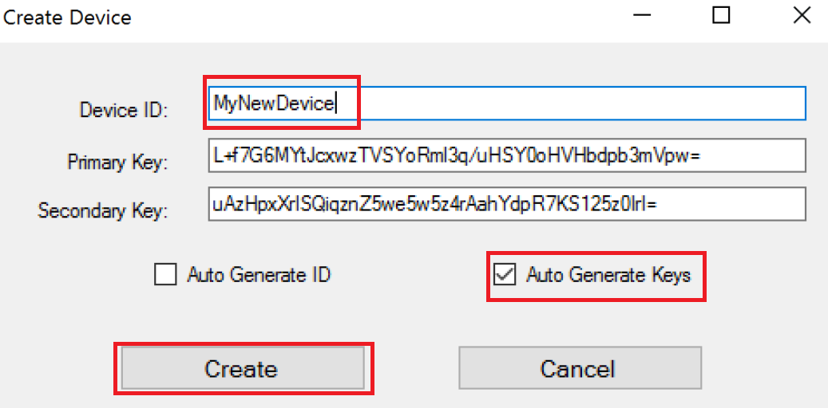
Provision and register a device
Notes:
Take note of DeviceId, you will use this later.

Slide 18
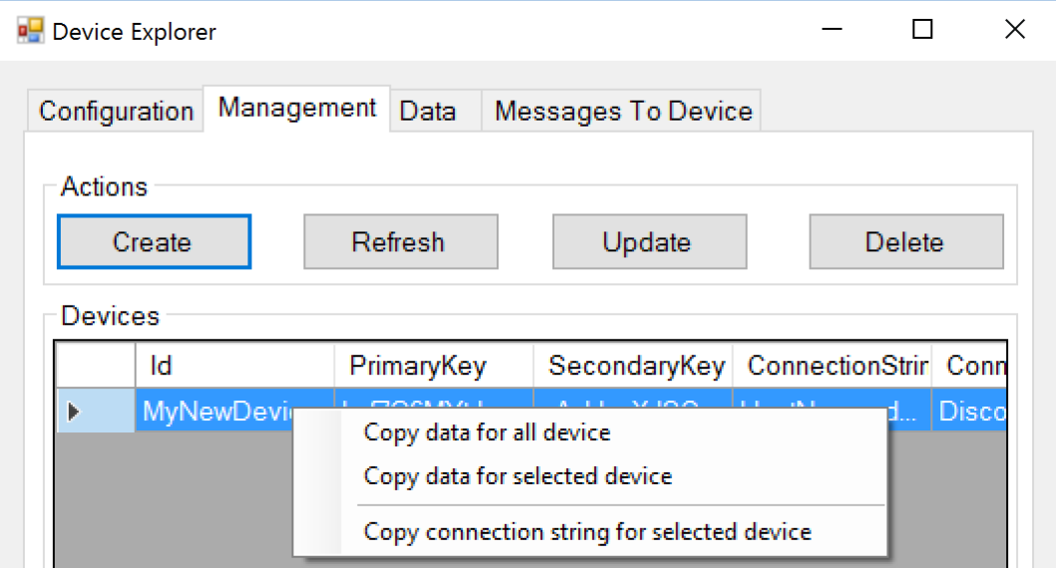
Get Device Connection String
Click on Device
Get Context
Select Copy Connection String

Slide 19
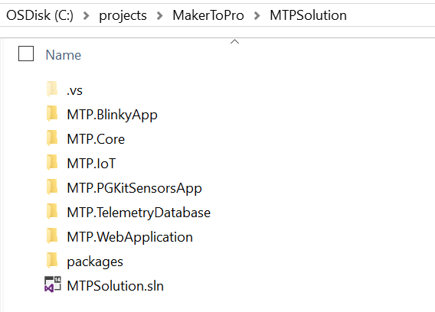
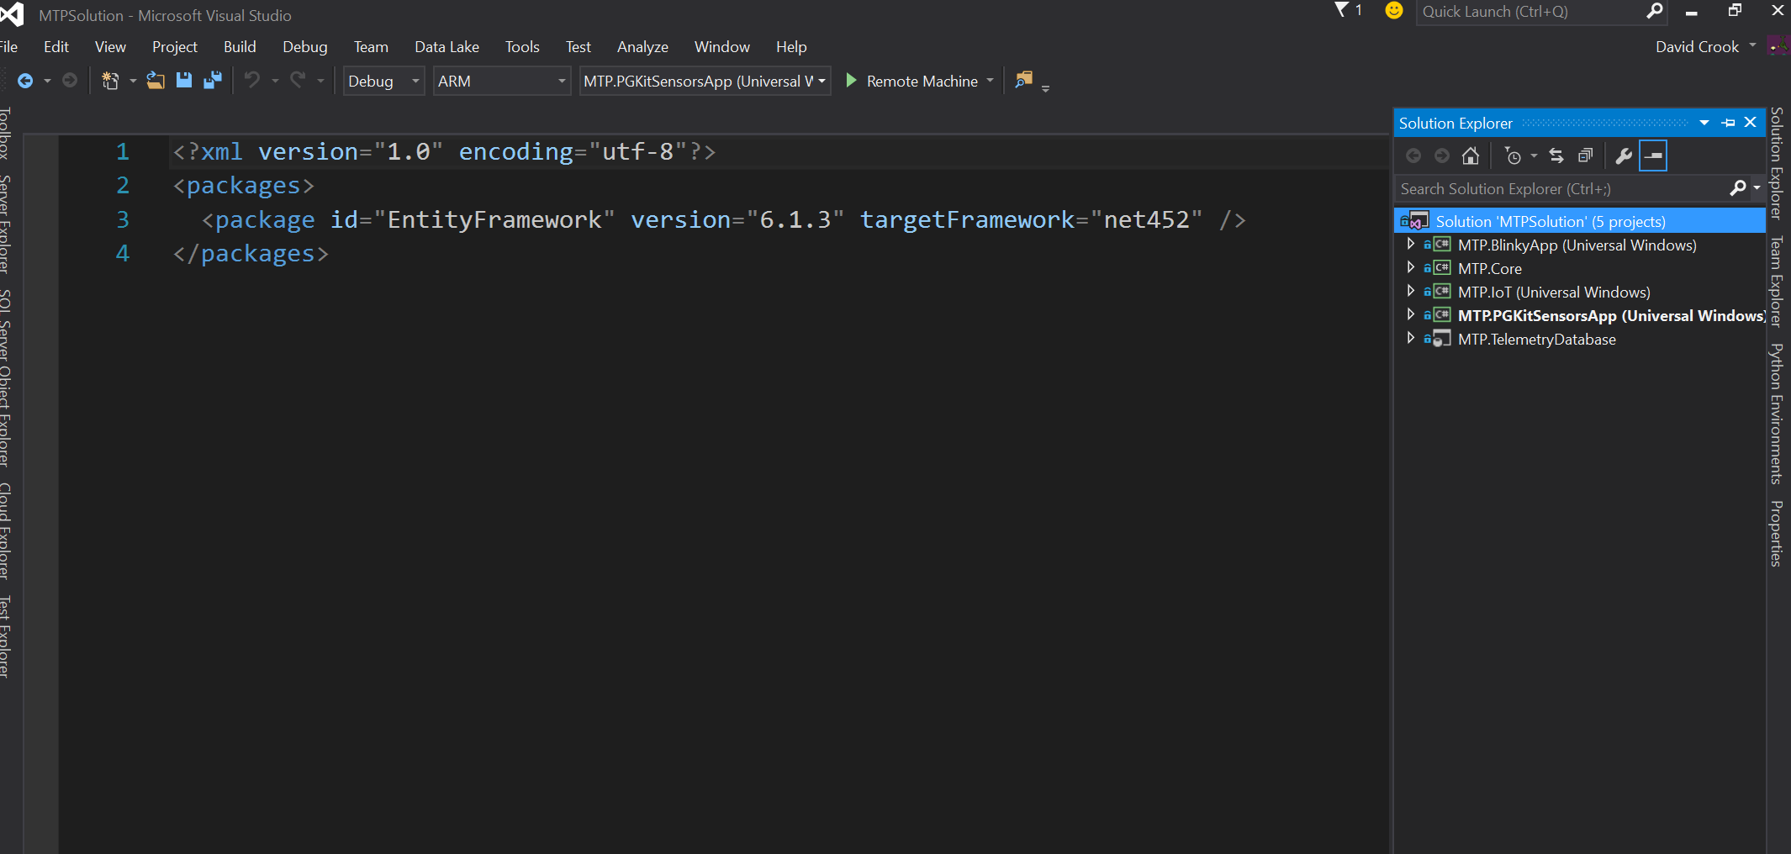
Open the Code
Open Visual Studio 2015 Community
Excellent programming tool.
Double Click .sln file
Opens in VS 2015

Slide 20
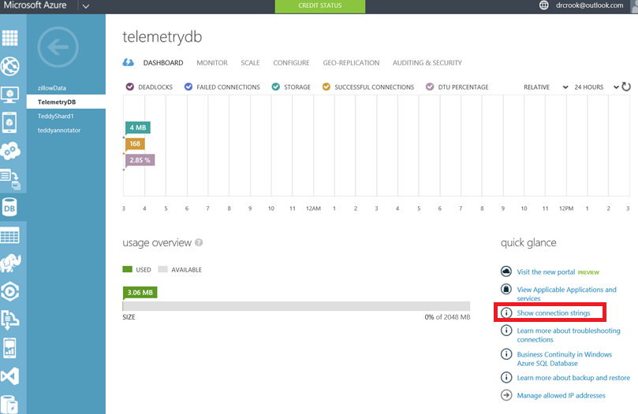
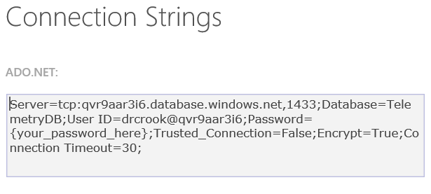
Get SQL Server Connection String

Slide 21
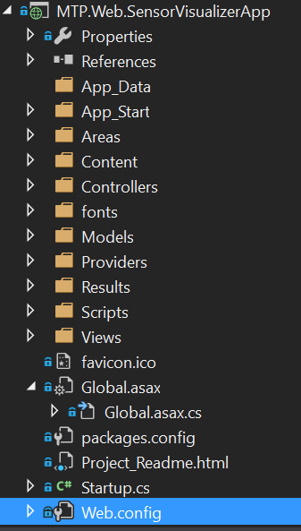
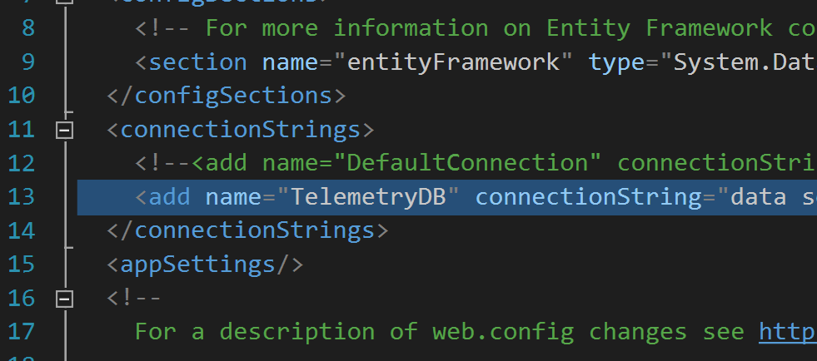
Configurations – Website Config
Replace with your connection string
Name must be “TelemetryDB”
Notes:
Add the SQL Connection String here. Remember to include your password. This name is being looked for by Entity Framework.

Slide 22
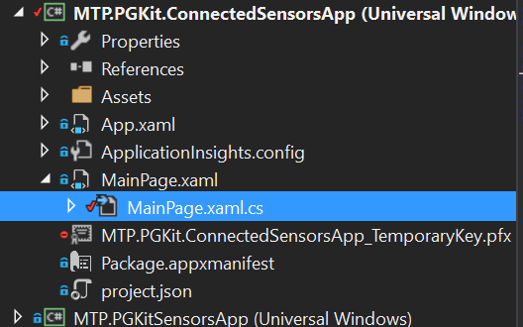
Configurations - Device Config
Your Location
Your DeviceId
Your IoTHub Conn String
Notes:
Use the IoT Hub Connection String specific to your device acquired from the Device Explorer tool.

Slide 23
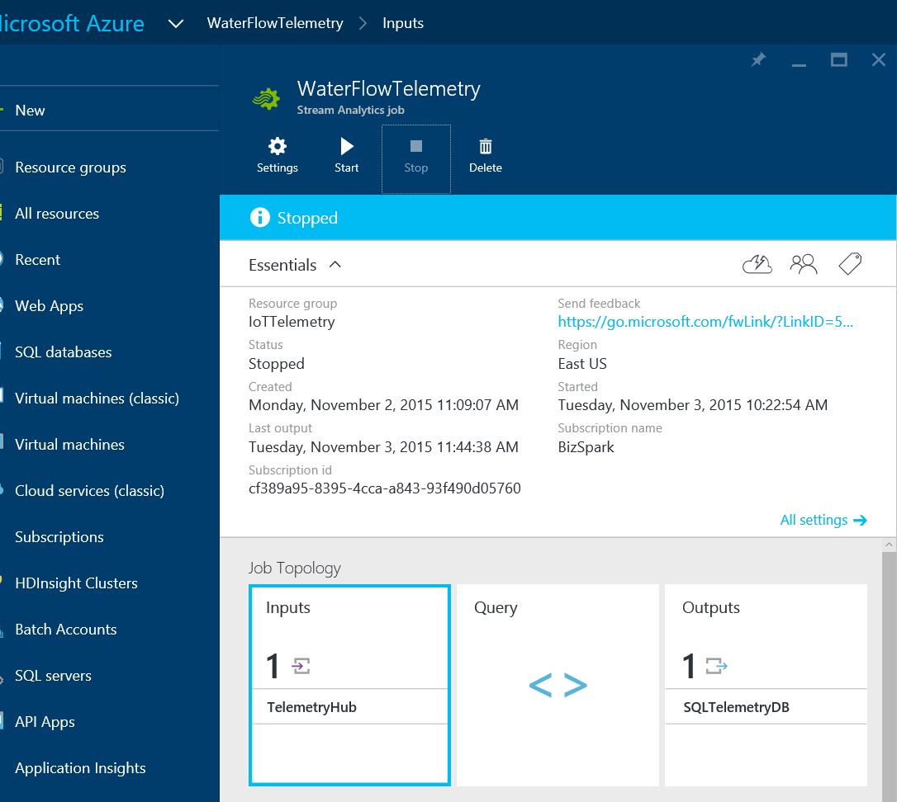
Stream Analytics Configuration
Notes:
Show from new portal getting to Stream Analytics

Slide 24
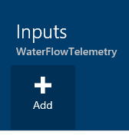
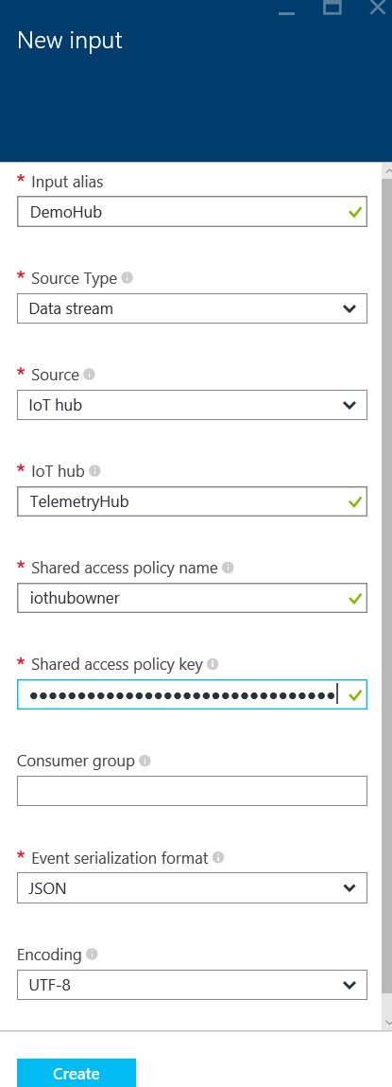
Stream Analytics - Input
Notes:
Show where to get data from. Helpful to have two new portals open at the same time.

Slide 25
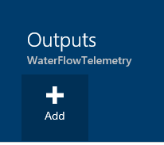
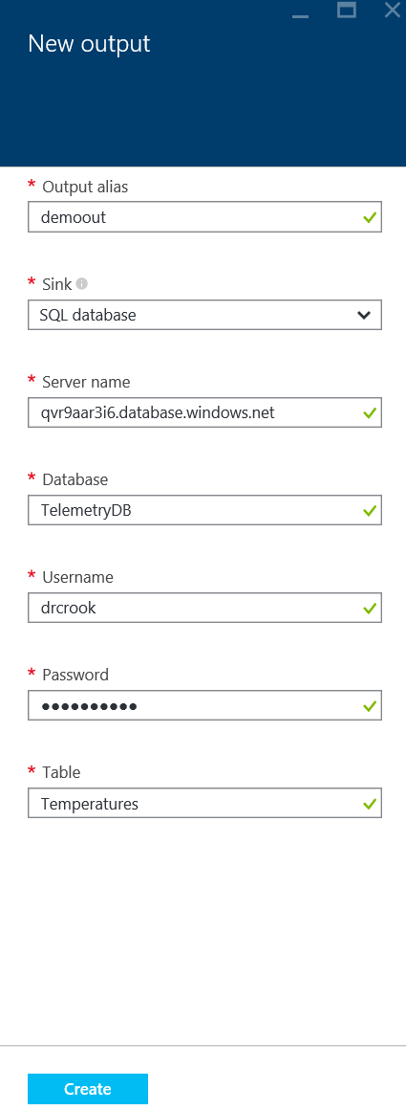
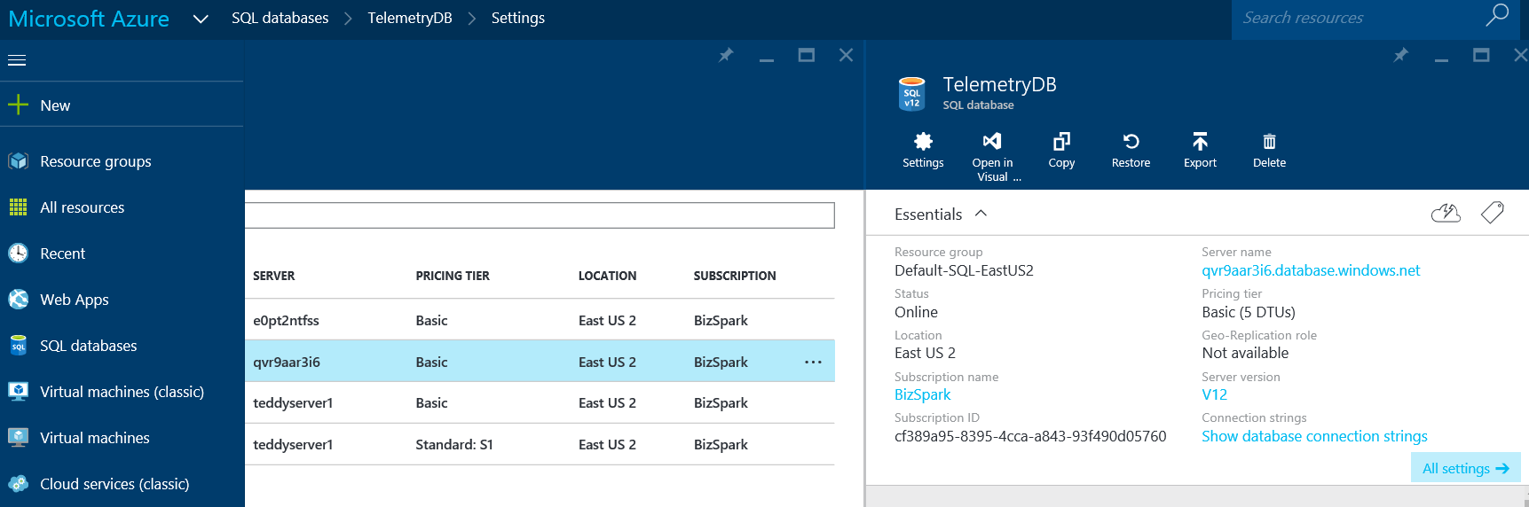
Stream Analytics - Output

Slide 26
Stream Analytics - Query
SELECT
Location, Temperature, CollectionTime, DeviceId
FROM
TelemetryHub
Notes:
Notice that “INTO” is not defined. As it currently stands, adding an into statement and using the output alias causes an error in which the data is not successfully dumped into the output store. Set only a single output and drop the into statement.
The from statement is the alias name for the input defined earlier.

Slide 27
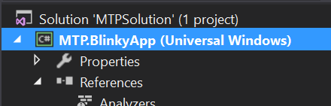
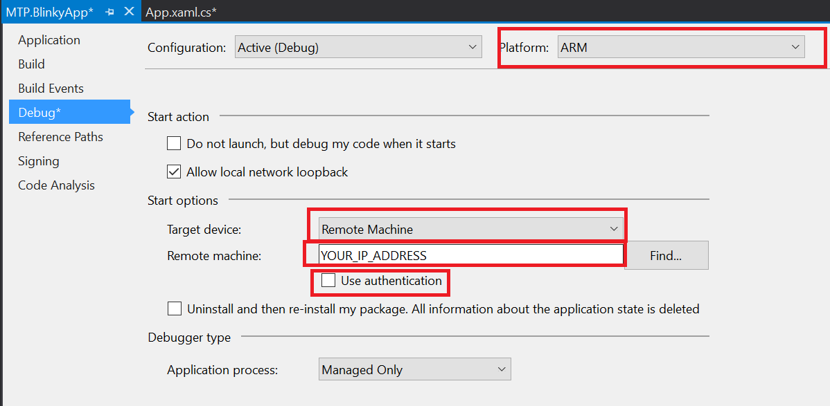
Set Build for your Device
Right Click Project
Properties (at the bottom)
ARM
Remote
Your IP
No Auth

Slide 28
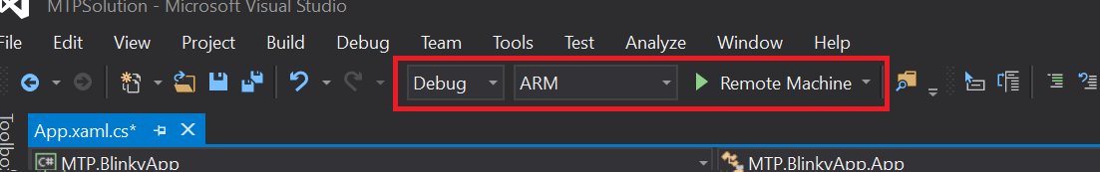
Deploy && Debug
Set to ARM
Click In Gray Area
Creates red breakpoint
Click Green Arrow
You can remove breakpoint and click green arrow to continue.

Slide 29
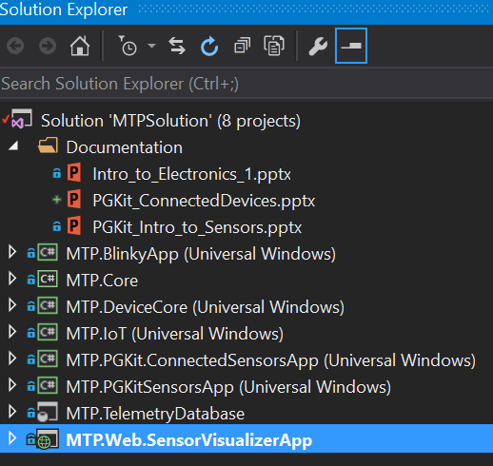
Debug Visualization Website
Open a second VS 2015
Right Click -> Debug

Slide 30
Code Walk Through

Slide 31
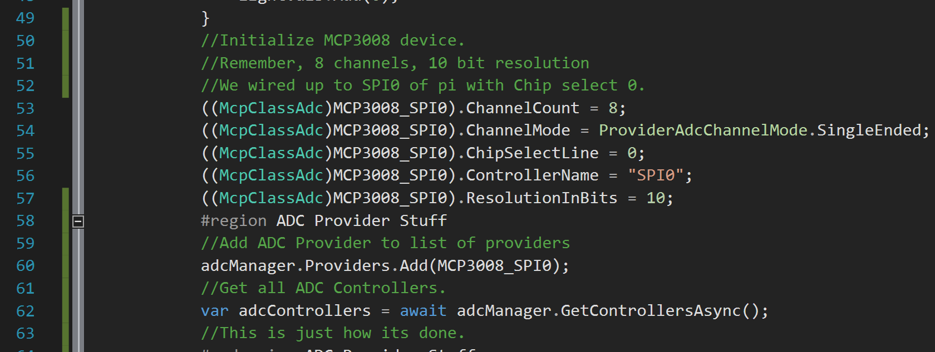
Code Walk Through
Notice extensive comments ☺
Notes:
Walk through the Event Hub pushing.

Slide 32
Blank
Stuff

Slide 33
What Next?

Slide 34
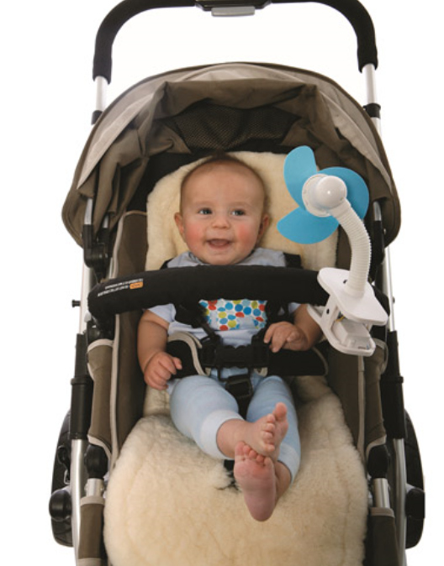
Baby Thermostat!
Is it too hot for baby?
Turn on the Fan!
Too cold for baby?
Turn off the Fan!

Slide 35
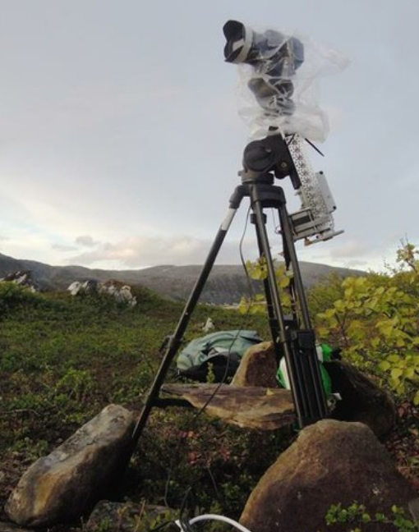
Light and Temp Tracking Camera
Use 2 of each sensor
Find a signature and follow it!

Slide 36
There is more!

Slide 37

Brown Bag Series
Electronics 101
3 Rotating Sessions
IoT 101
3 Rotating Sessions
Machine Learning 101
2 Rotating Sessions
3D Printing 101
Just 1 session!

Slide 38
Questions?

Slide 39
dacrook@Microsoft.com
(980)228-6278
@Data4Bots
www.indiedevspot.com

